Slide 1
Exists

Slide 2
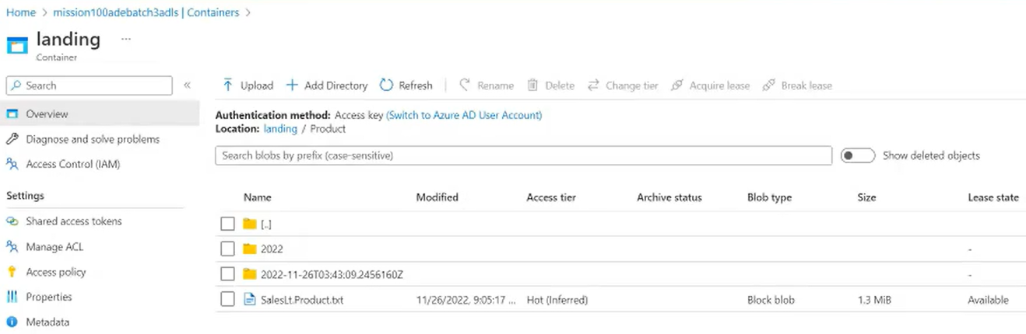

Slide 3
